Slide 1
Multispectral Imaging
Genome 575: Fundamentals of Biomedical Instrumentation
Brian Beliveau

Slide 2
Recap from last time
Light in optical systems primarily comes from incandescence and fluorescence
Fluorescence relies on the excitation and decay of fundamental particles (usually e⁻)
The propagation of light can be altered by reflection, refraction, and absorption

Slide 3
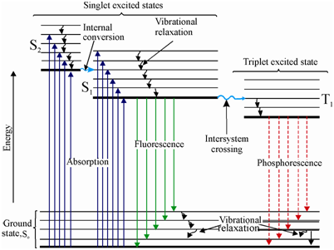
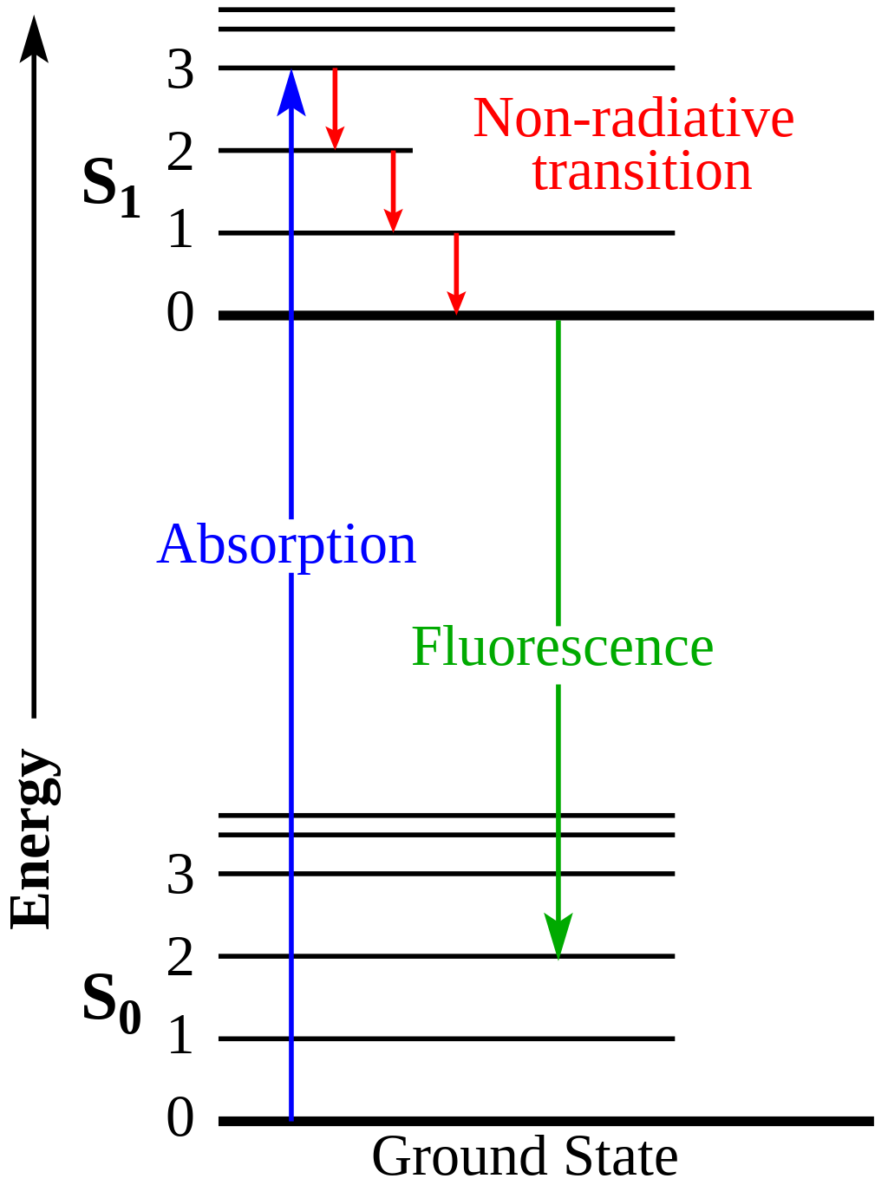
From Monday…
DNA
Melanin
Kinetic
energy
Heat
Jablonski diagram
https://en.wikipedia.org/wiki/Jablonski_diagram#/media/File:Jablonski_Diagram_of_Fluorescence_Only-en.svg, https://www.expertsmind.com/topic/fluorimetry-and-phosphorimetry/jablonski-diagram-913753.aspx

Slide 4
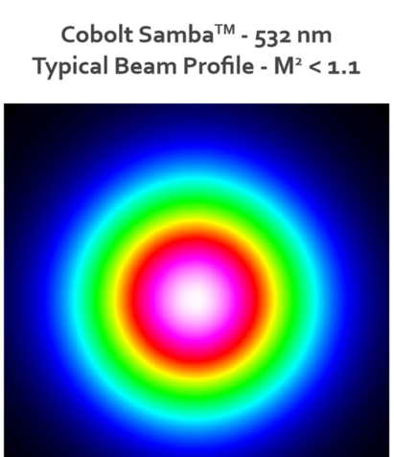
From Monday, part 2
Your camera chip (white) and Gaussian laser beam profile are shown ->
Is this set-up ideal for quantitative imaging? Why or why not?
Given the assumptions below, calculate the power density of the cyan box in kW/cm^2. How does this compare to the intensity of the sun?
The central white + purple area is roughly uniform in intensity at 100 mW
The cyan box is 1024 x 1024 100 nm pixels
Devise an engineering solution to make the illumination intensity uniform over the white box
https://hubner-photonics.com/wp-content/uploads/2020/05/Performance-data-beam-profile-04-01-Series.png

Slide 5
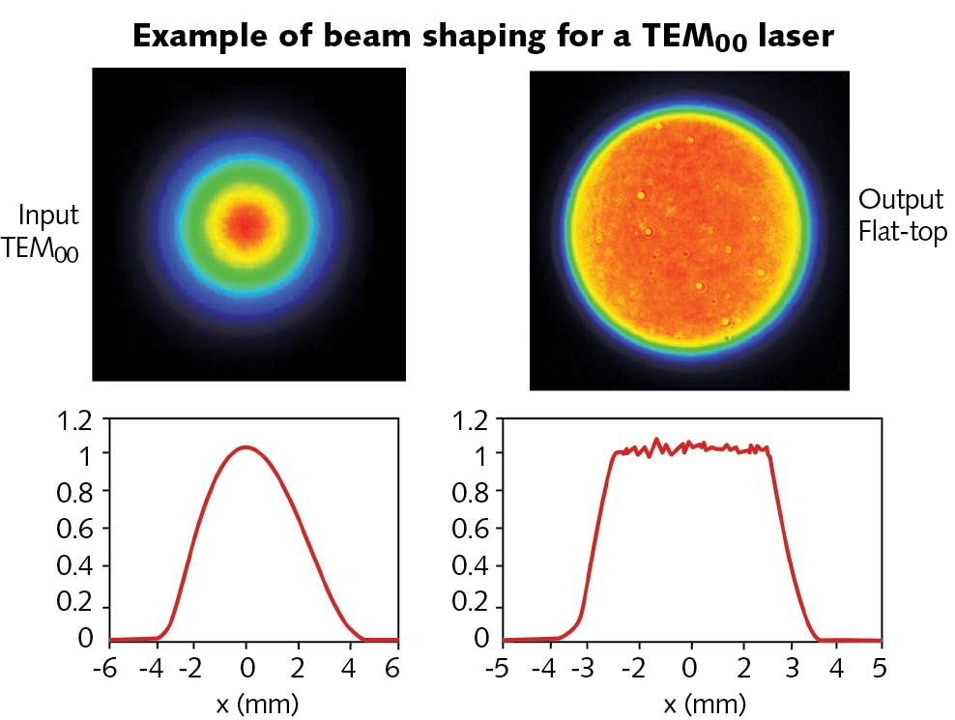
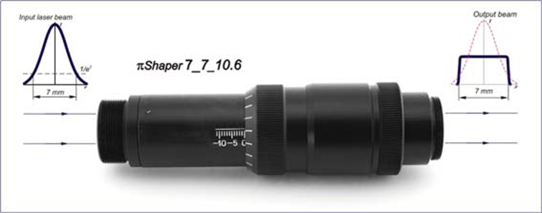
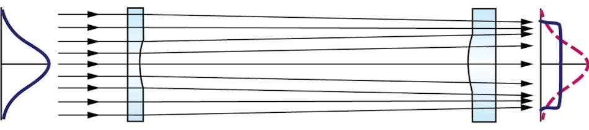
Solution 1: Refractive beam shaping
https://www.laserfocusworld.com/optics/article/14197298/flat-top-laser-beams-their-uses-and-benefits, https://pishaper.com/shaper.html

Slide 6
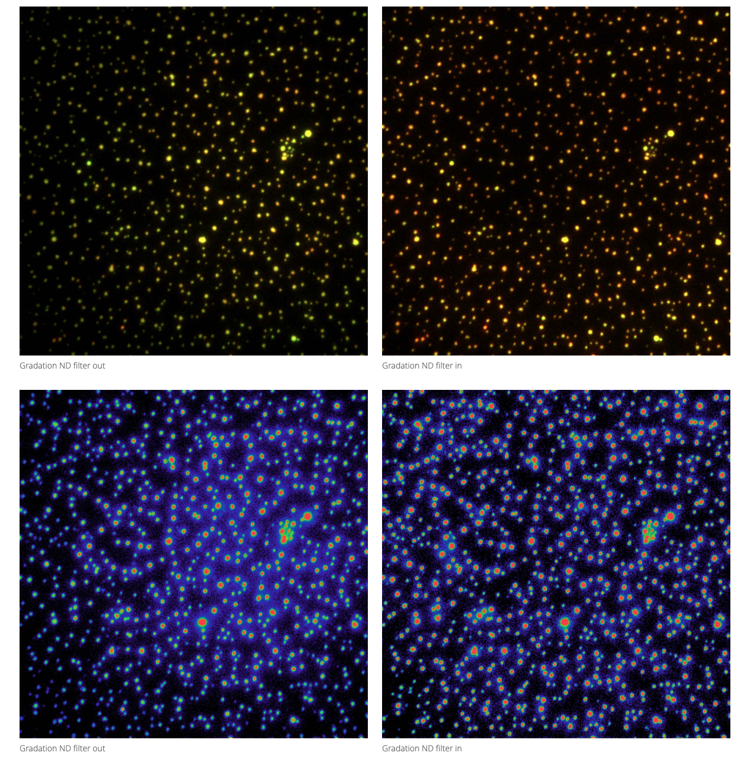
Solution 2: Gradation ND filter
Filter out
Filter in
https://www.microscope.healthcare.nikon.com/products/photostimulation-tirf/ti2-lapp

Slide 7
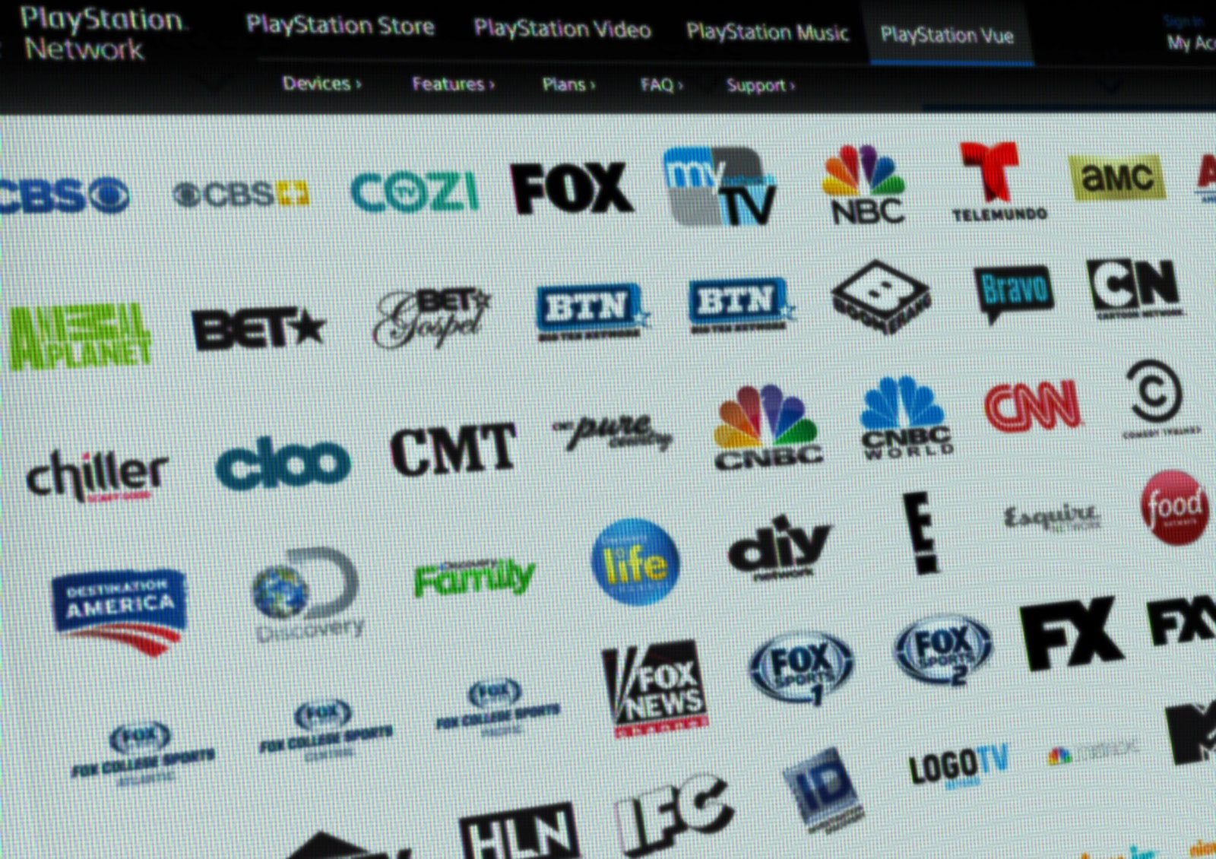
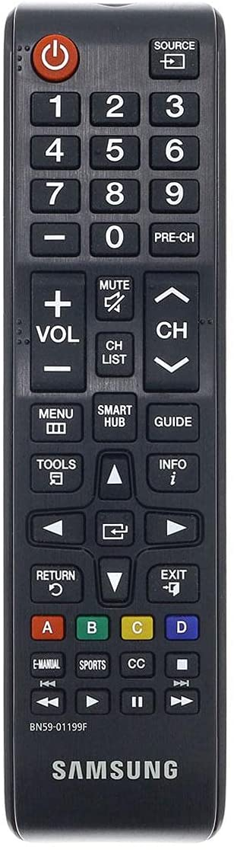
Picking your imaging bundle
How many channels are in a typical microscope?
What bounds this number? (10 mins)
https://media.newyorker.com/photos/59096d2b6552fa0be682fed7/master/pass/Wu-Dreaded-Bundle-Comes-to-Internet-TV1.jpg, https://m.media-amazon.com/images/I/51ZSG3TqyAS._AC_SL1500_.jpg

Slide 8
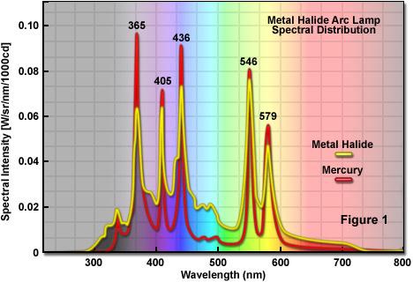
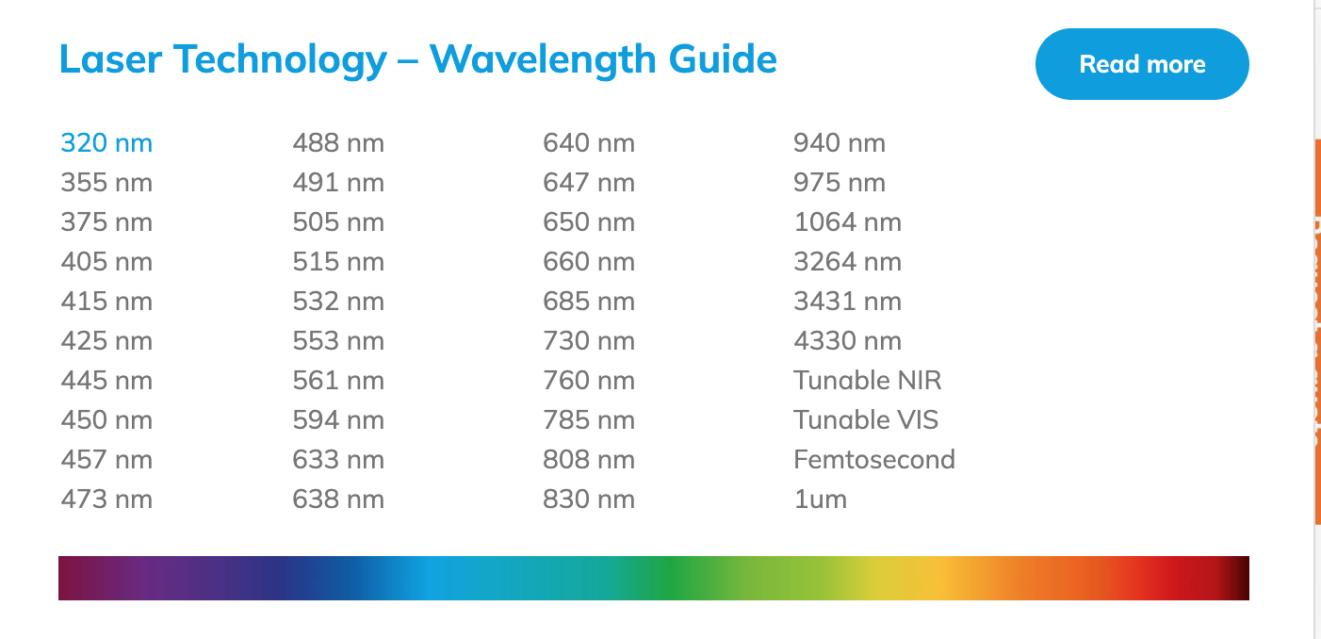
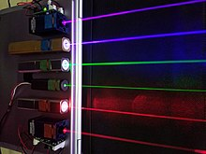
Multiplexing challenges: light sources
Most effective light sources bounded in UV-A, vis, near-IR
UV challenging to use with biological samples
https://en.wikipedia.org/wiki/File:Lasers.JPG , https://zeiss-campus.magnet.fsu.edu/articles/lightsources/images/metalhalidelampsfigure1.jpg, https://hubner-photonics.com/products/lasers/multi-line-lasers/

Slide 9
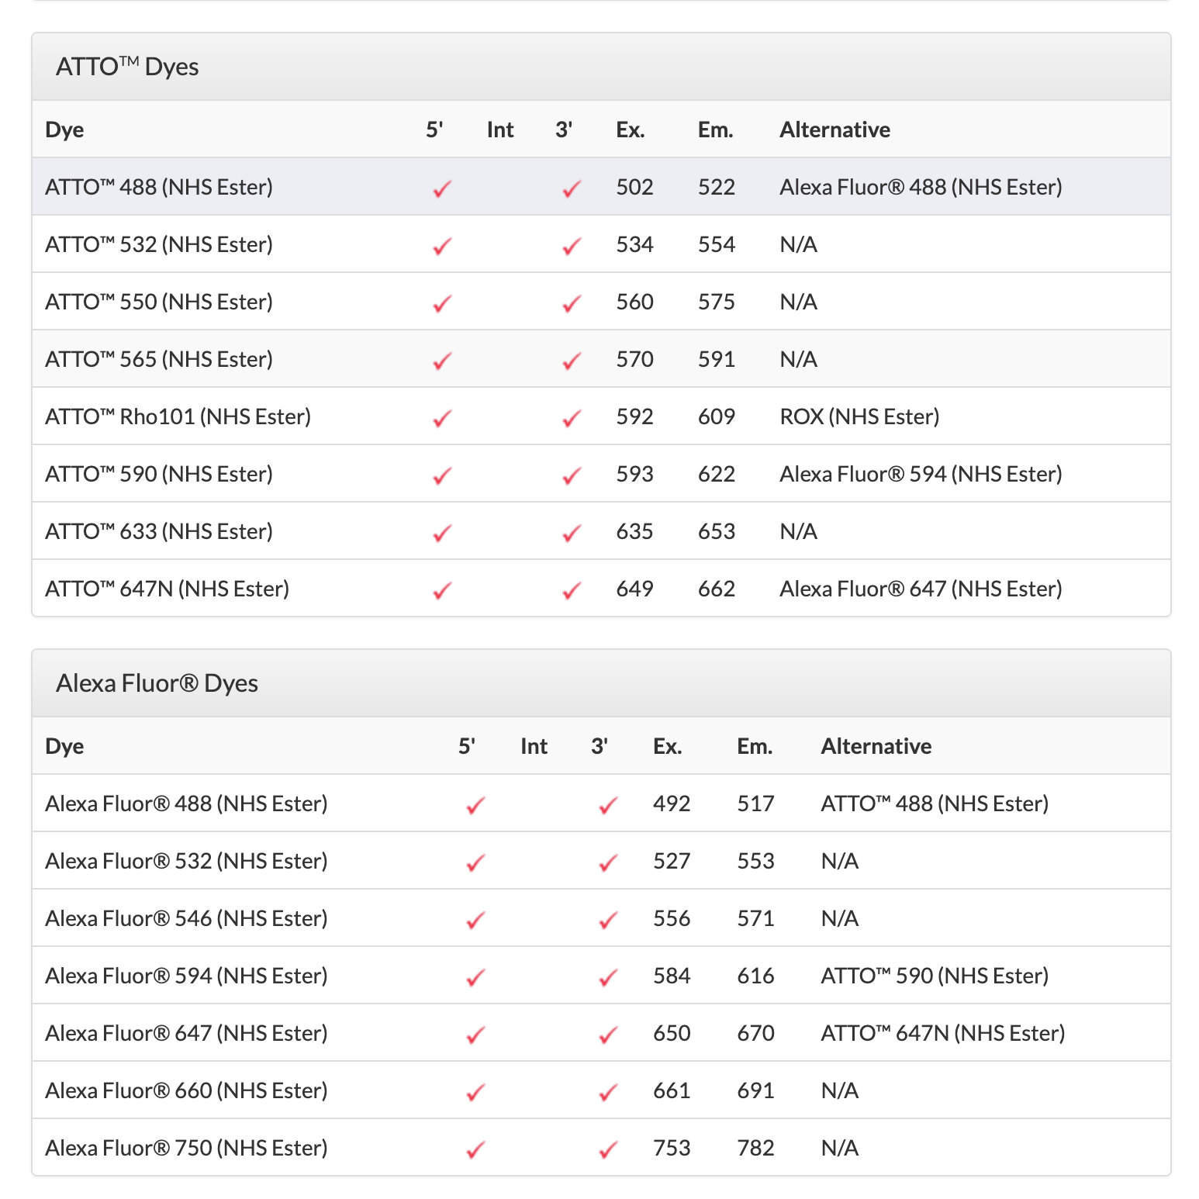
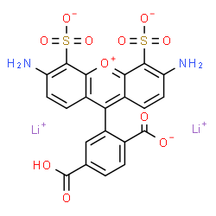
Multiplexing challenges: labels
AlexaFluor 488
Most effective dyes/labels concentrated in vis/near-IR
Rational design of organic dyes / FPs challenging
https://www.idtdna.com/site/Catalog/Modifications/Dyes, http://www.chemspider.com/Chemical-Structure.23107060.html

Slide 10
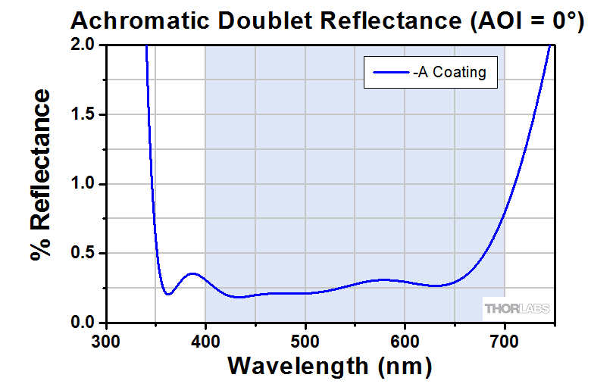
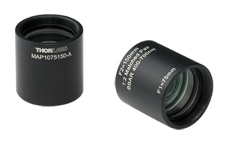
Multiplexing challenges: optics
“Achromatic doublet”
Most optics can only transmit over defined ranges
𝝀-dependent differences lead to chromatic aberration
https://www.thorlabs.com/images/TabImages/MAP_A_Reflectance-780.gif, https://www.thorlabs.com/Images/GuideImages/1716_MatchedDoublet_6.jpg

Slide 11
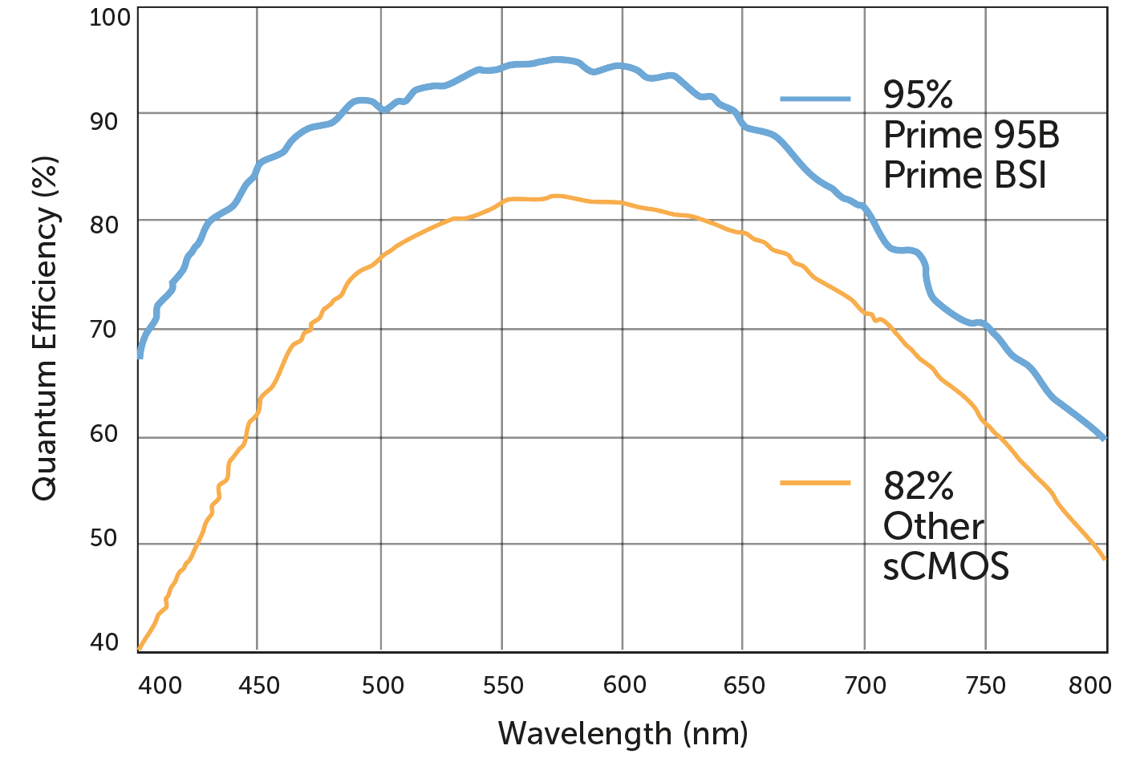
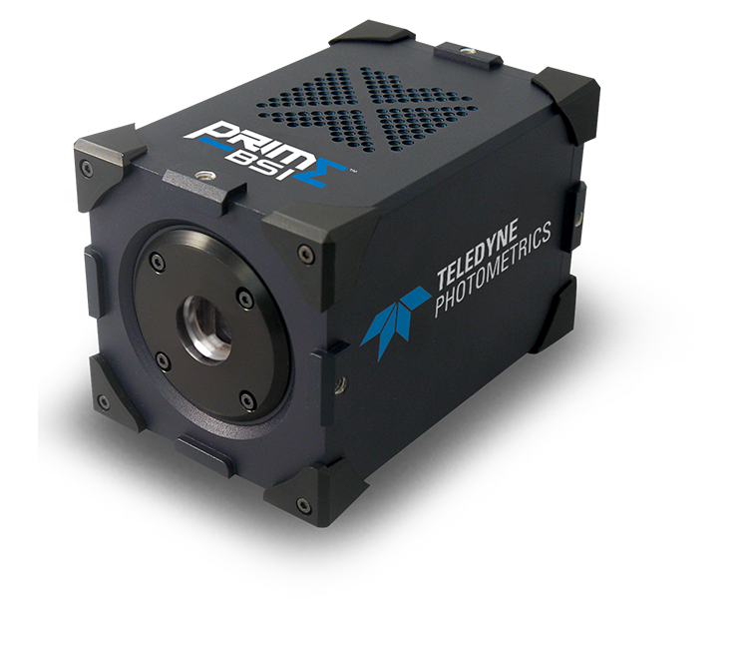
Multiplexing challenges: detectors
CCD/sCMOS sensors most effective in vis
PMTs (laser scanning confocals/FACS) drop off a cliff in IR
https://www.photometrics.com/wp-content/uploads/2019/09/QE-curve.png, https://www.photometrics.com/wp-content/uploads/2019/09/prime-bsi-shadow-750x696.png

Slide 12
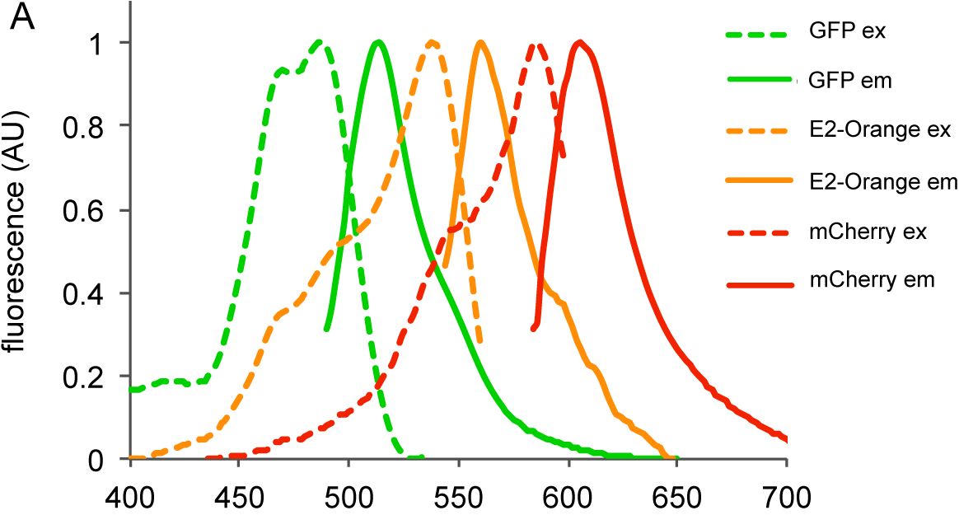
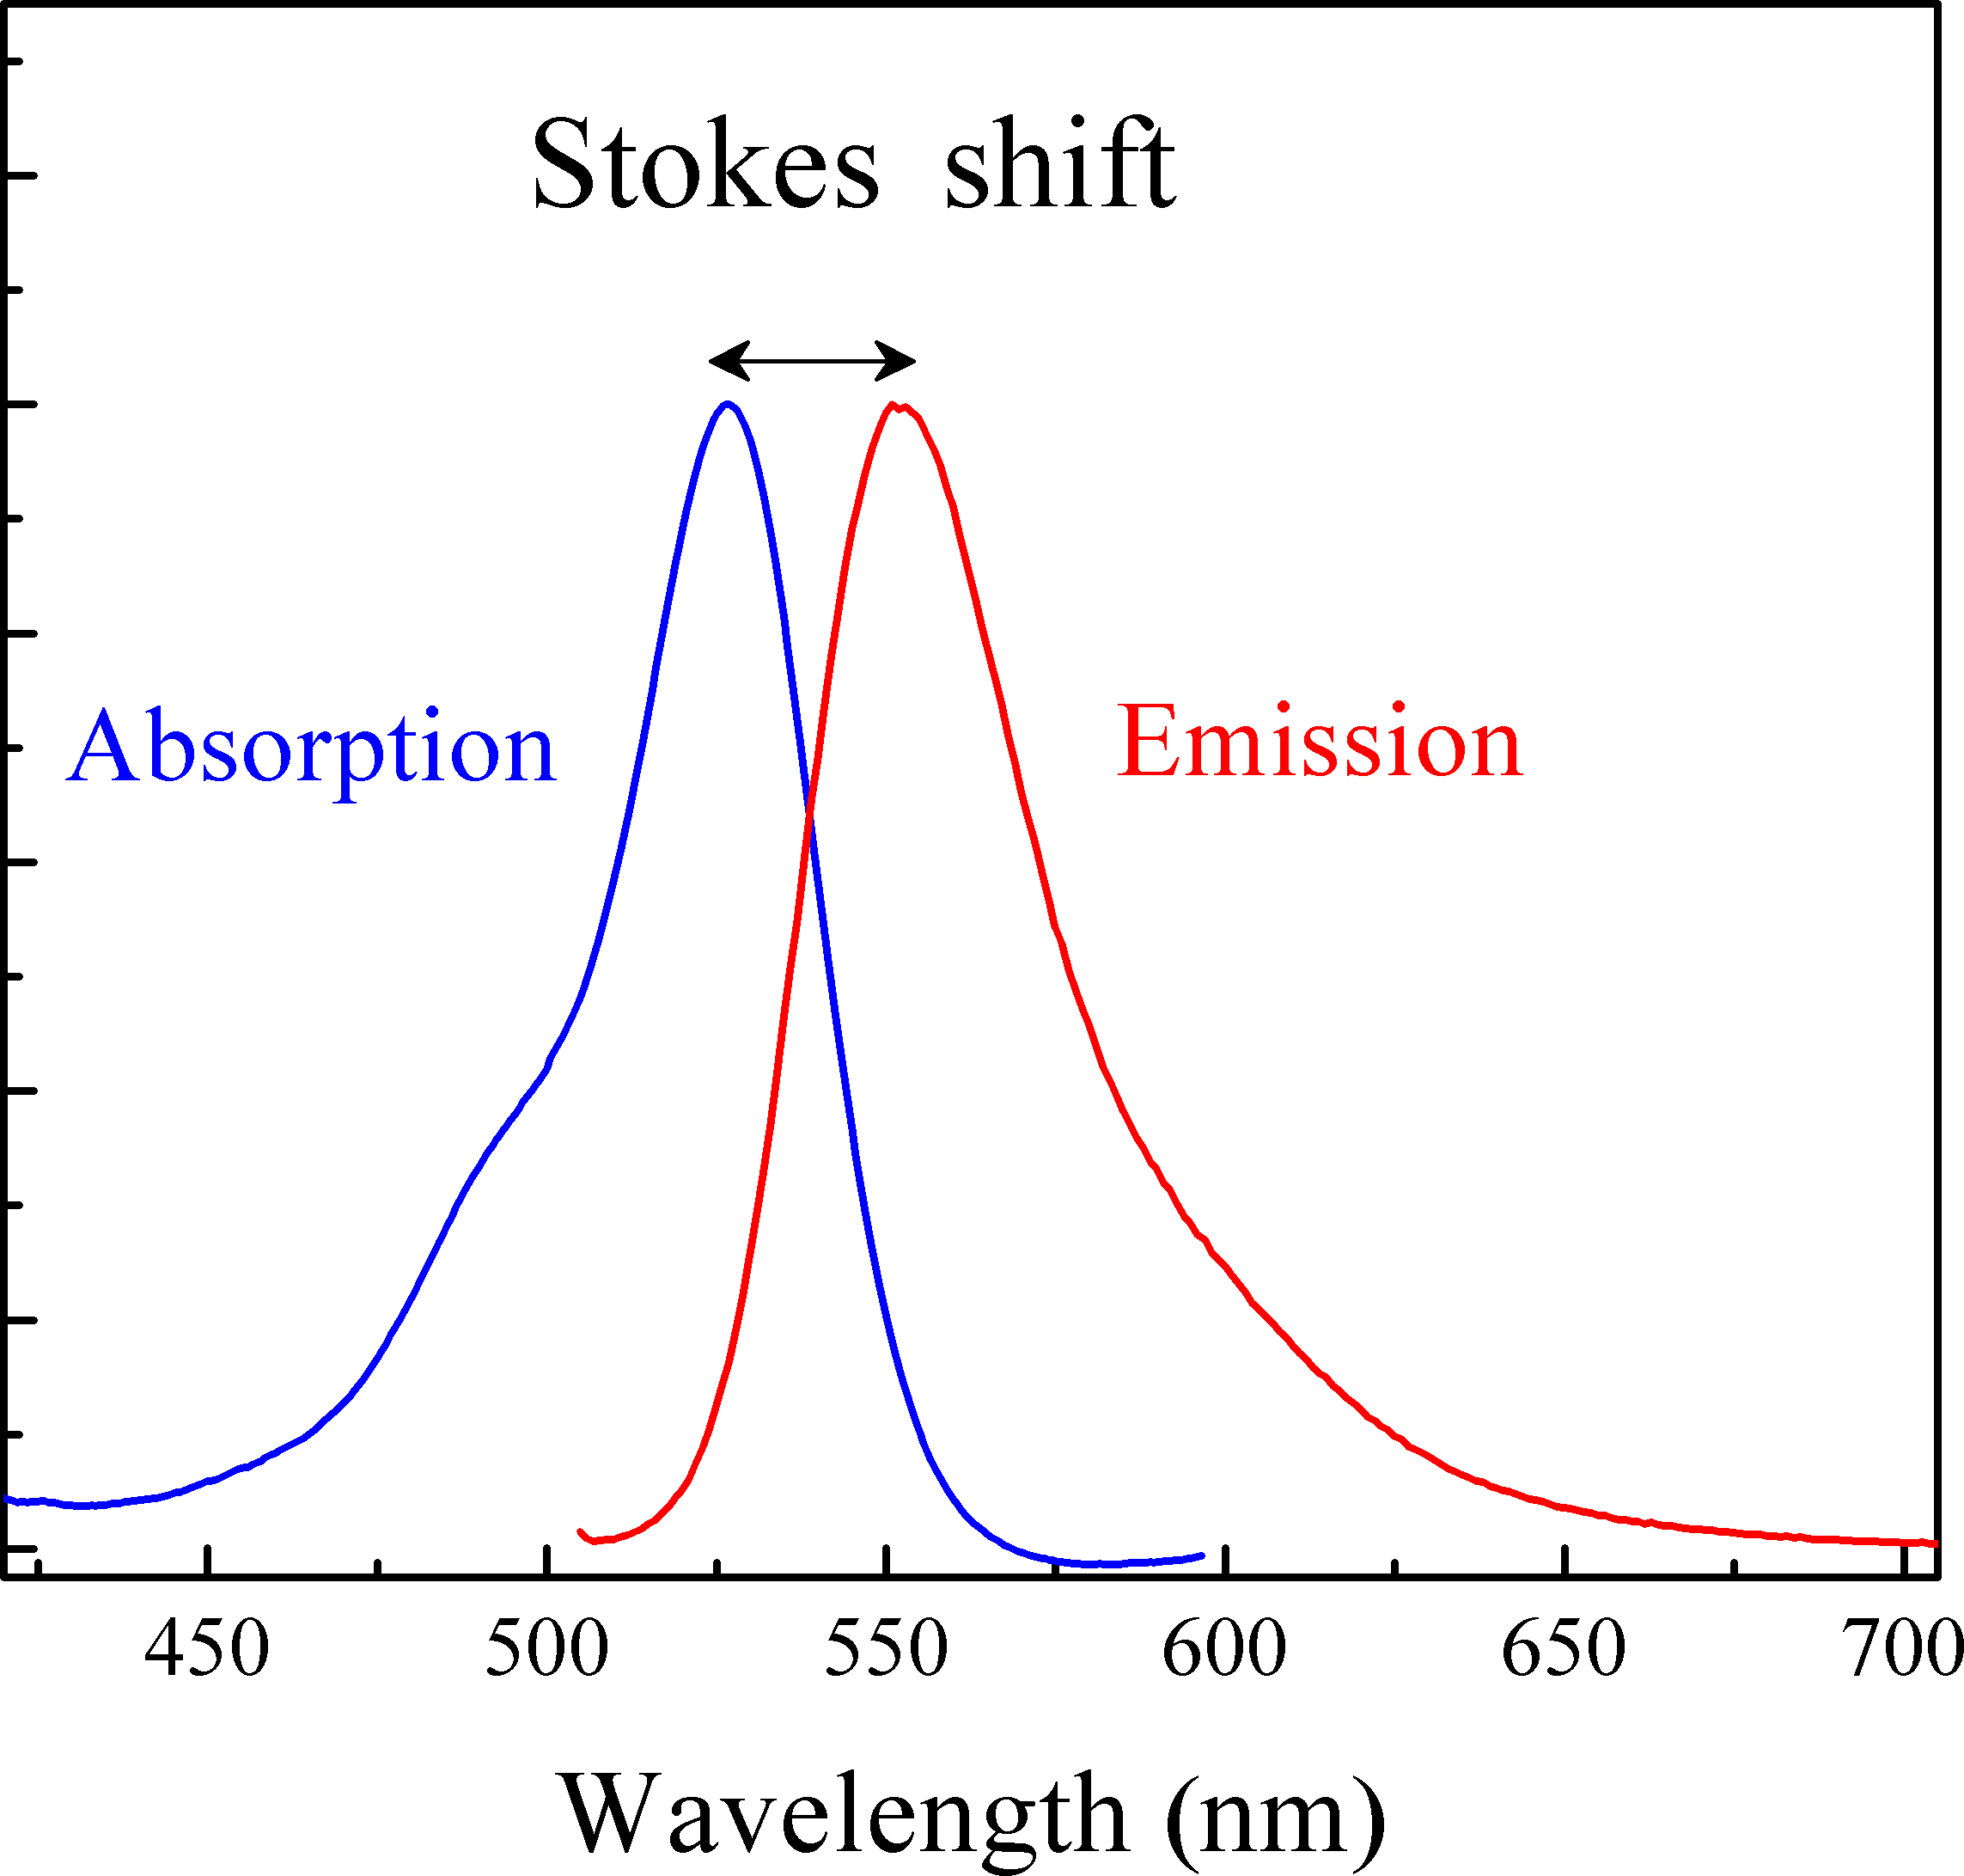
Multiplexing challenges: Stokes shifts
Stokes shift: max(Em) – max(Ex)
Width, spacing of Ex/Em peaks a huge factor in multiplexing
https://journals.plos.org/plosone/article/file?id=10.1371/journal.pone.0122848.g001&type=large, https://upload.wikimedia.org/wikipedia/commons/3/3f/Stokes_shift-_Rh6G.png

Slide 13
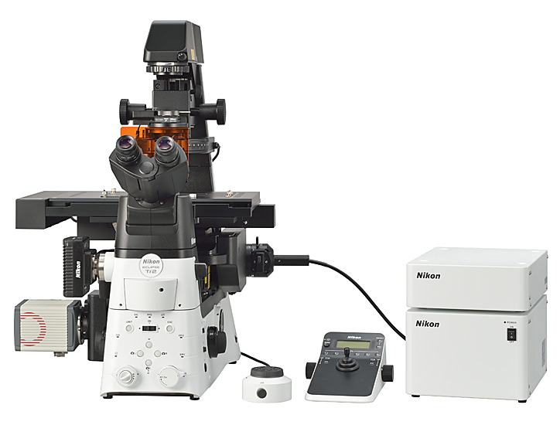
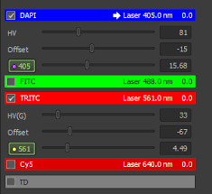
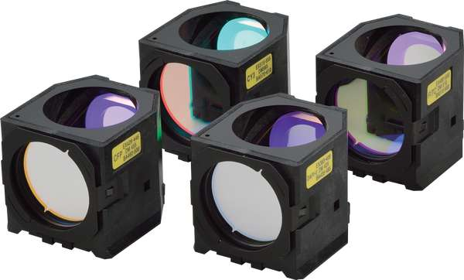
Defining an imaging channel
How is the microscope sub-setting the EM spectrum around a defined “channel”?
Light source (?), filter cube
https://encrypted-tbn0.gstatic.com/images?q=tbn:ANd9GcQGjmZByoM2TiwIz-P2benxkUGzlX3QJBgl2X7lUi5taLUpQLx0SmSb66f9A6v6PA0ui30&usqp=CAU, https://www.nikon.com/news/2016/img/pic_161109_01.jpg, https://d33b8x22mym97j.cloudfront.net/production/imager/productphotos/827/filter-cubes-main_ec7d1033075031a0254a7350f4e87eb4.jpg

Slide 14
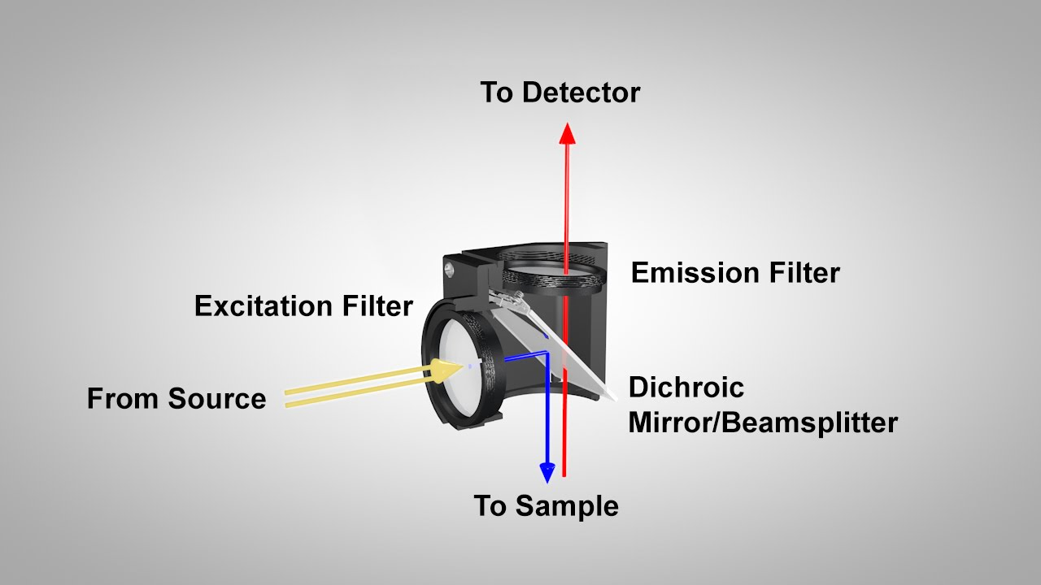
The anatomy of a filter cube
Ingredients: Ex filter (bandpass), DM (long-pass), Em fiter (bandpass)
Flip orientation 180º for inverted microscopes
https://i.ytimg.com/vi/y4dJOFUVk30/maxresdefault.jpg, https://d33b8x22mym97j.cloudfront.net/production/imager/productphotos/827/filter-cubes-main_ec7d1033075031a0254a7350f4e87eb4.jpg

Slide 15
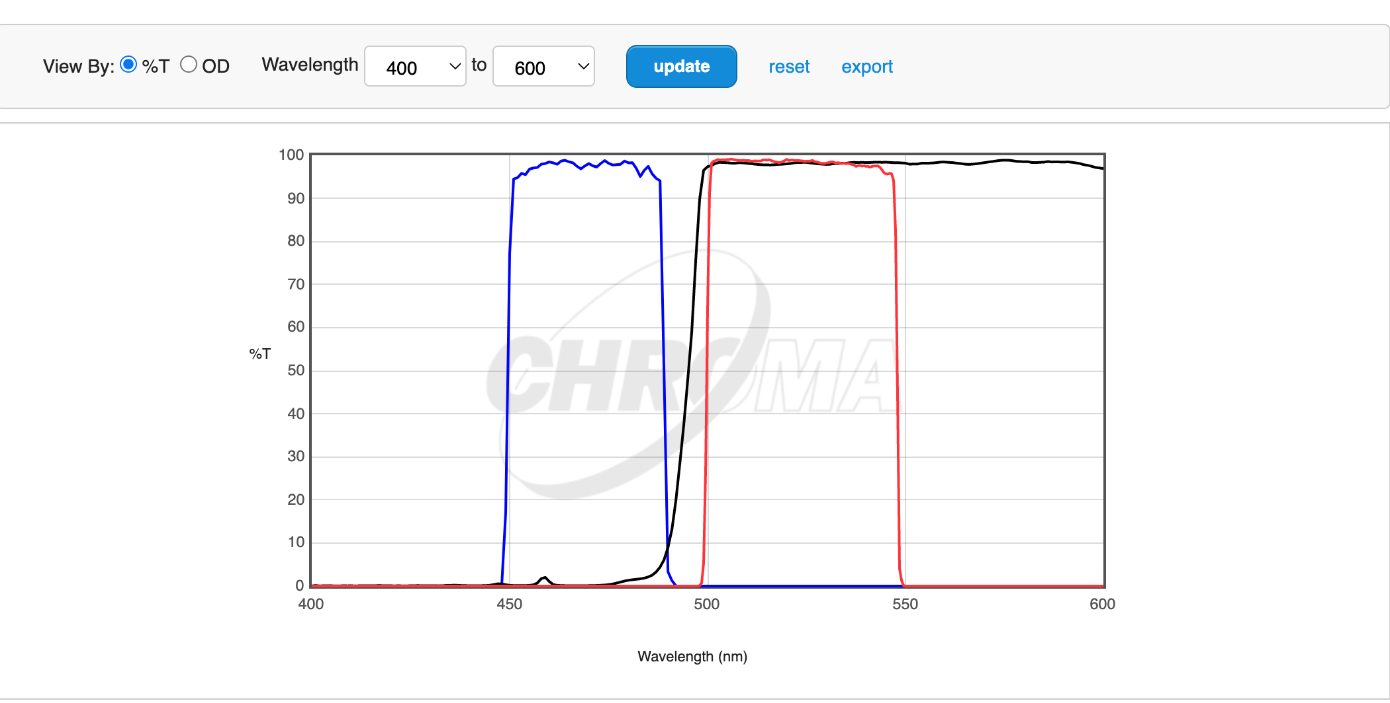
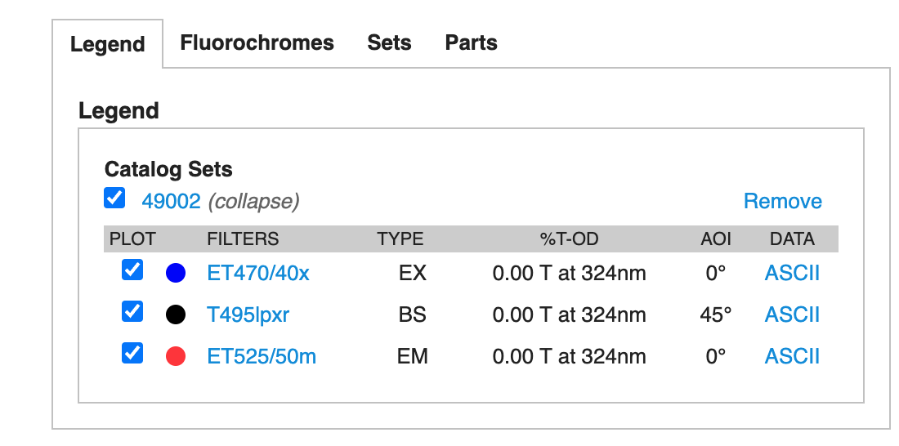
An example filter cube
https://d33b8x22mym97j.cloudfront.net/production/imager/productphotos/827/filter-cubes-main_ec7d1033075031a0254a7350f4e87eb4.jpg, https://www.chroma.com/products/sets/49002-et-egfp-fitc-cy2

Slide 16
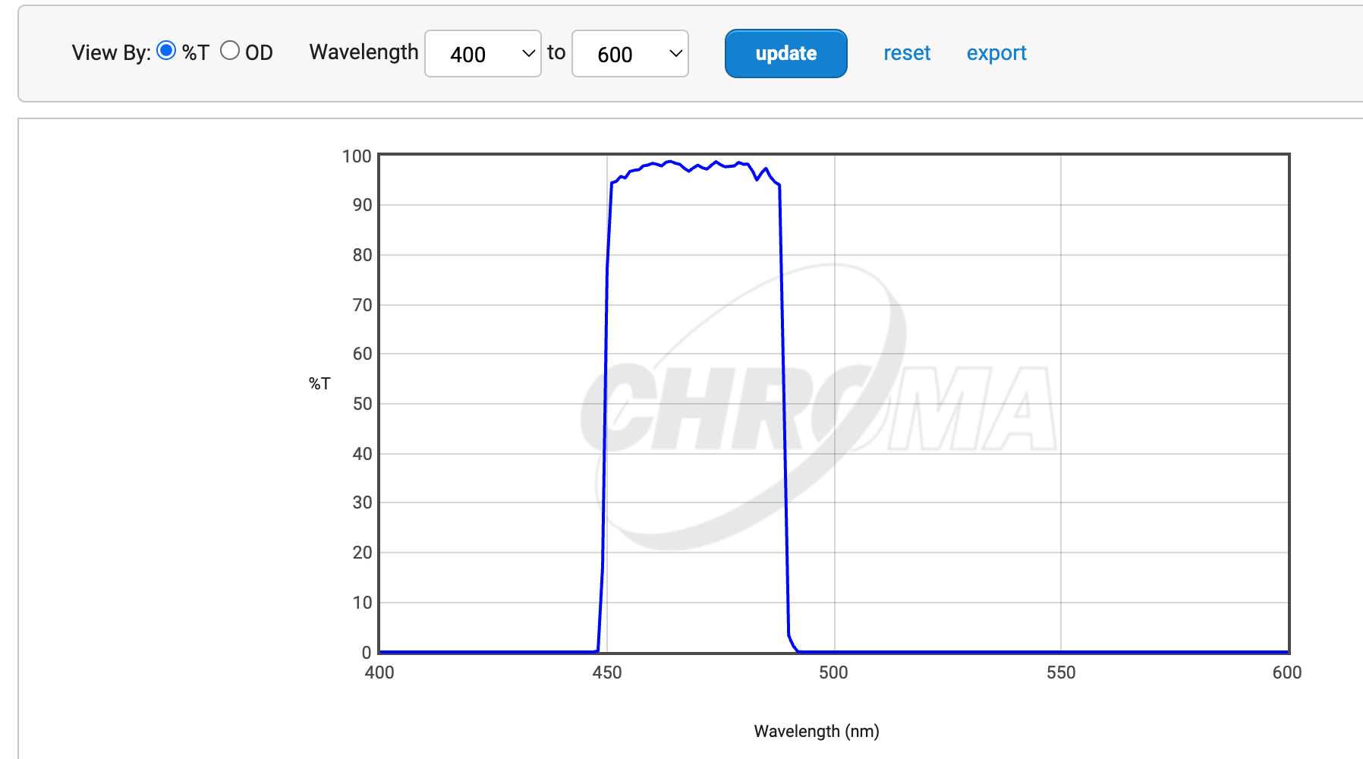
An example filter cube: Ex filter
Bandpass
Transmit 450 – 490 nm
https://d33b8x22mym97j.cloudfront.net/production/imager/productphotos/827/filter-cubes-main_ec7d1033075031a0254a7350f4e87eb4.jpg, https://www.chroma.com/products/sets/49002-et-egfp-fitc-cy2

Slide 17
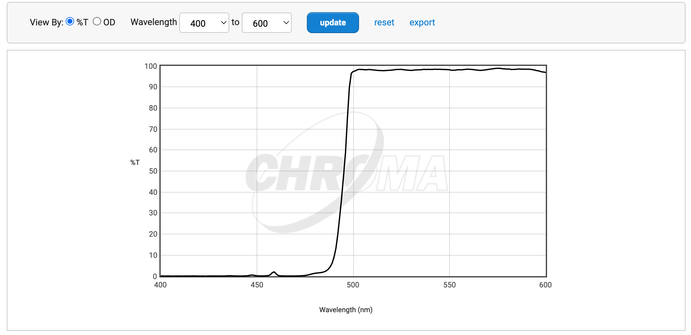
An example filter cube: dichroic mirror
Longpass “beam splitter”
<495 nm: Reflect
≥495 nm: Transmit
https://d33b8x22mym97j.cloudfront.net/production/imager/productphotos/827/filter-cubes-main_ec7d1033075031a0254a7350f4e87eb4.jpg, https://www.chroma.com/products/sets/49002-et-egfp-fitc-cy2

Slide 18
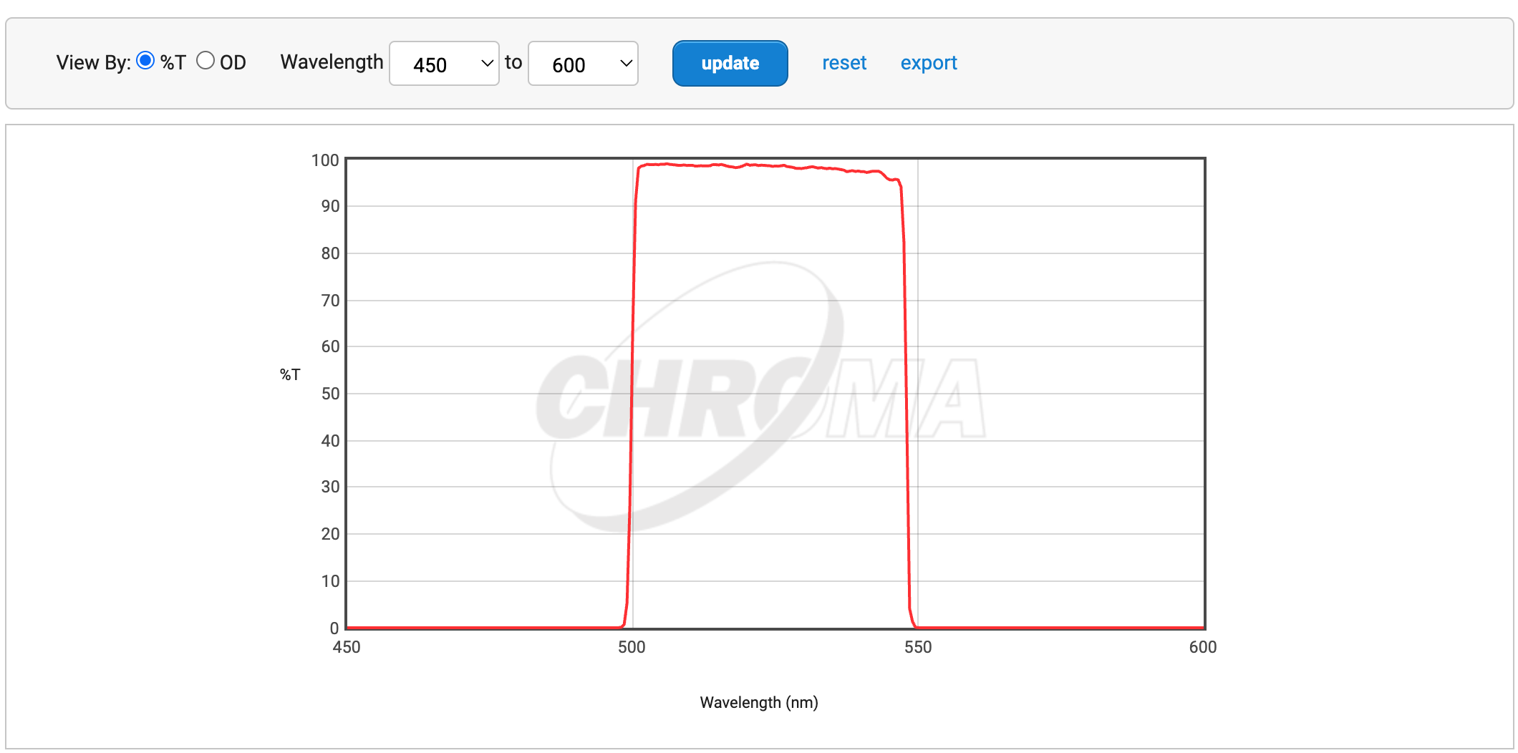
An example filter cube: Em filter
Bandpass
Transmit 500 – 550 nm
https://d33b8x22mym97j.cloudfront.net/production/imager/productphotos/827/filter-cubes-main_ec7d1033075031a0254a7350f4e87eb4.jpg, https://www.chroma.com/products/sets/49002-et-egfp-fitc-cy2

Slide 19
An example filter cube
Excitation: 450 – 490 nm
Separation: 490 – 500 nm
Collection 500 – 550 nm
https://d33b8x22mym97j.cloudfront.net/production/imager/productphotos/827/filter-cubes-main_ec7d1033075031a0254a7350f4e87eb4.jpg, https://www.chroma.com/products/sets/49002-et-egfp-fitc-cy2

Slide 20
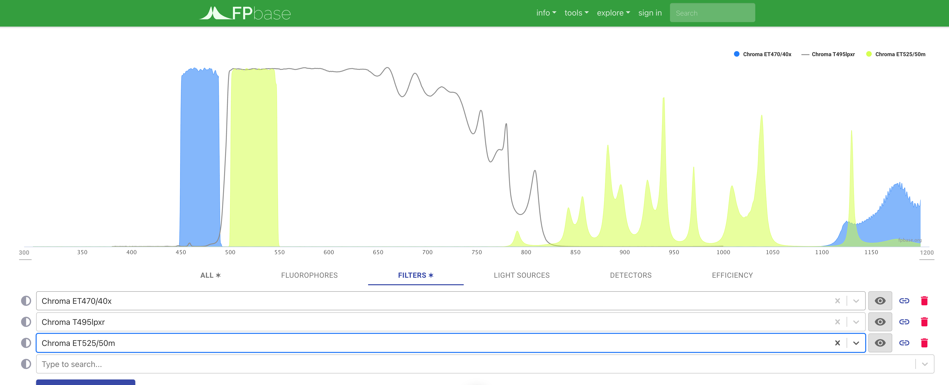
Evaluating filter cubes
https://www.fpbase.org/spectra/
https://d33b8x22mym97j.cloudfront.net/production/imager/productphotos/827/filter-cubes-main_ec7d1033075031a0254a7350f4e87eb4.jpg, https://www.chroma.com/products/sets/49002-et-egfp-fitc-cy2

Slide 21
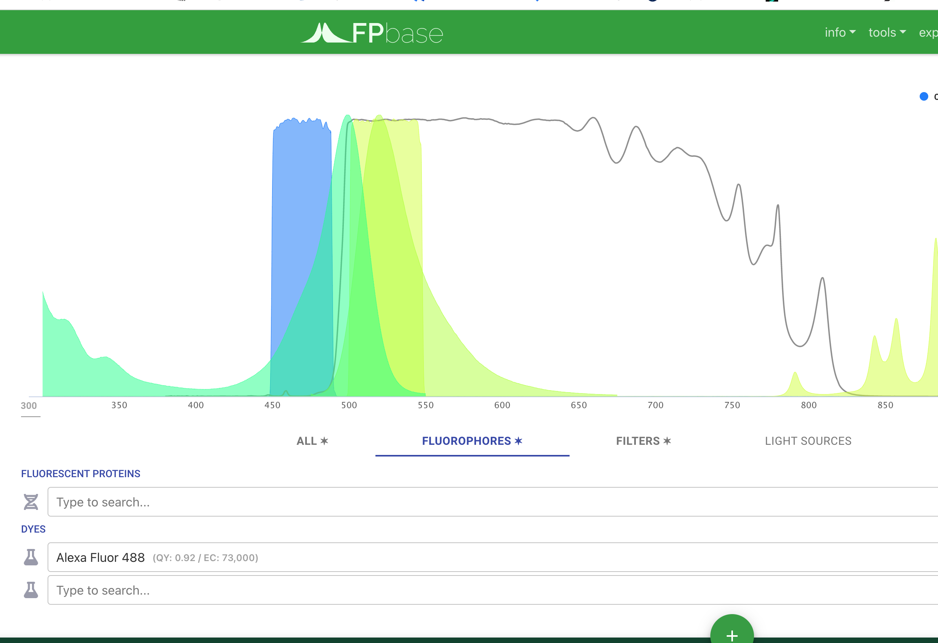
Evaluating filter cubes
https://www.fpbase.org/spectra/
https://d33b8x22mym97j.cloudfront.net/production/imager/productphotos/827/filter-cubes-main_ec7d1033075031a0254a7350f4e87eb4.jpg, https://www.chroma.com/products/sets/49002-et-egfp-fitc-cy2

Slide 22
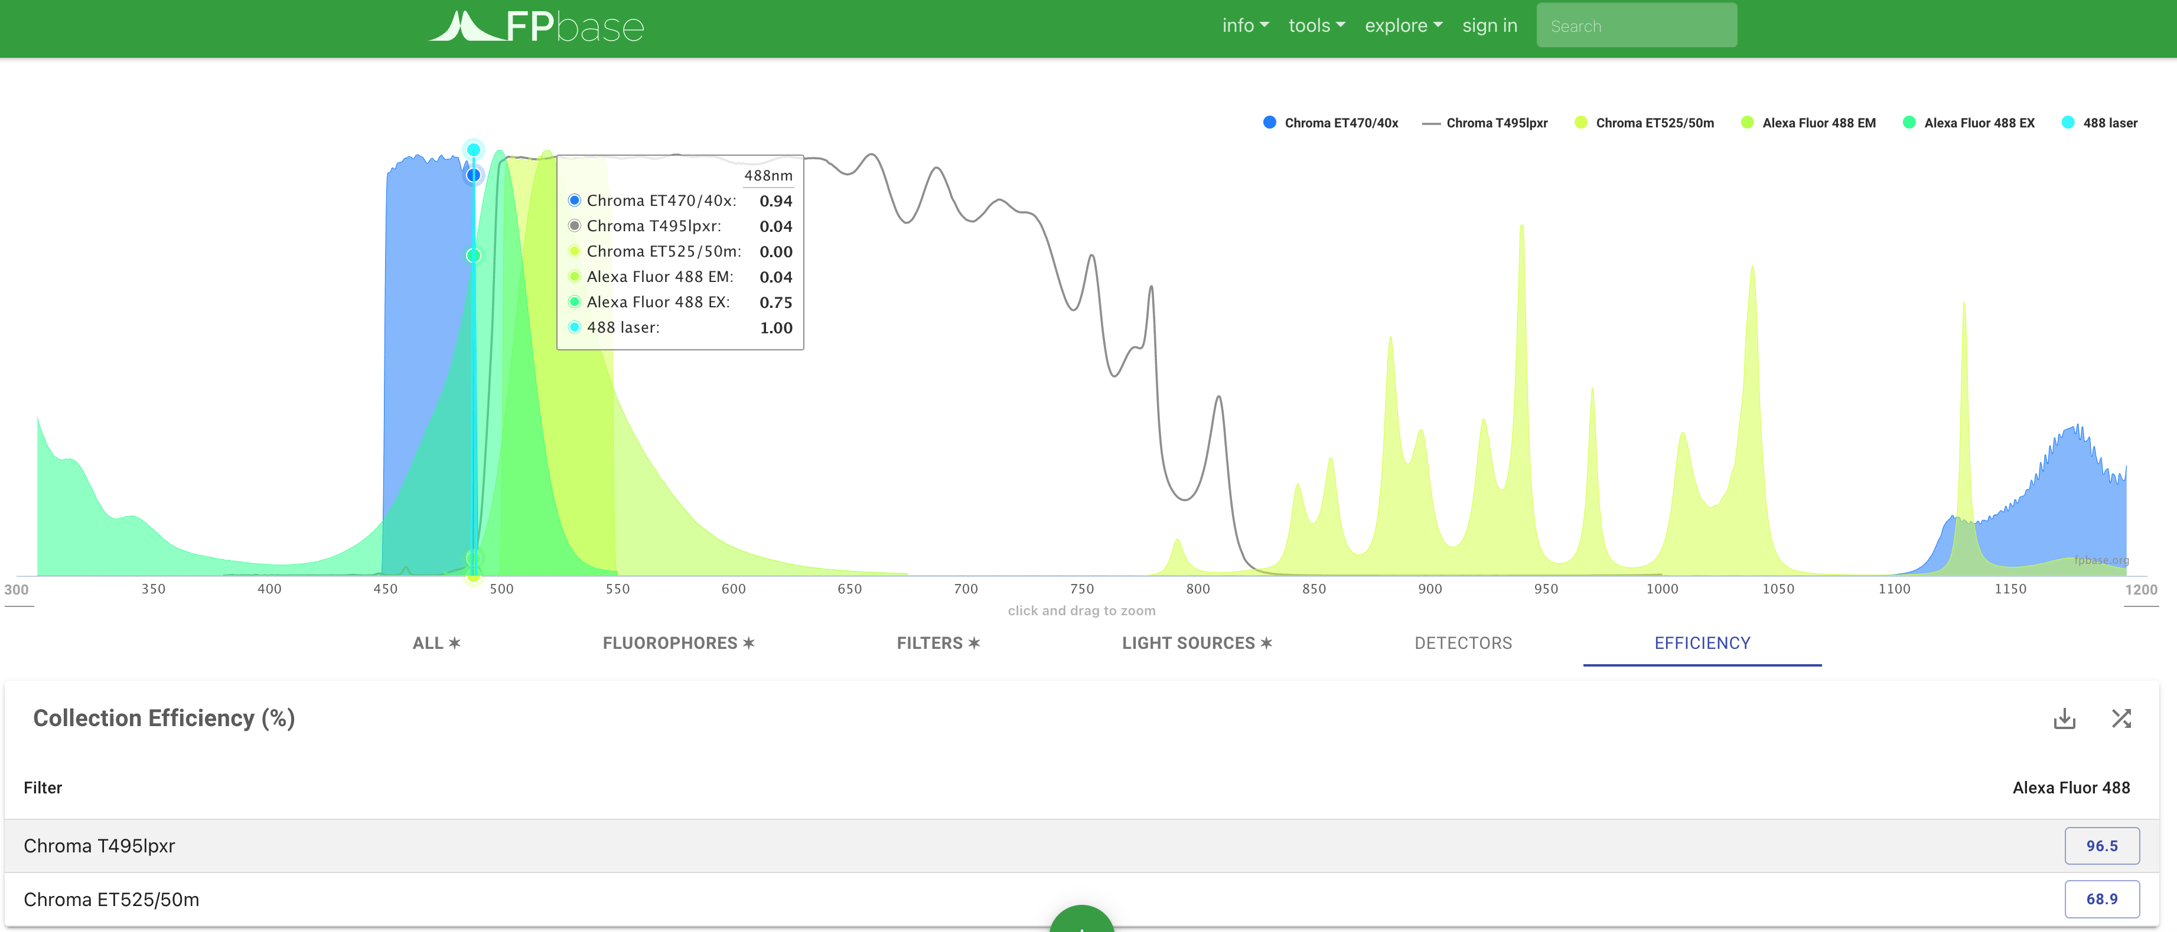
Evaluating filter cubes
https://www.fpbase.org/spectra/
Ex filter excitation efficiency: 75%
Em filter collection efficiency: 68.9%
https://d33b8x22mym97j.cloudfront.net/production/imager/productphotos/827/filter-cubes-main_ec7d1033075031a0254a7350f4e87eb4.jpg, https://www.chroma.com/products/sets/49002-et-egfp-fitc-cy2

Slide 23
Class activity 1: design a filter set (15 mins)
Assume you have the following laser lines: [405 nm, 488 nm, 532 nm, 561 nm, 594 nm, 640 nm]
Go to https://www.fpbase.org/spectra/
Select the dye “Cy3B” under the ‘Fluorophores’ tab and your choice(s) of laser in the ‘Light Sources’ tab
Design an “ideal” custom filter set (Ex, DM, Em) in the ‘Filters’ tab. You can substitute a long-pass “LP” filter for the DM (ie, only consider the transmission band)
Report your ‘Efficiency’ for Cy3B detection. You can set T% to 100 for all filters. Allow no excitation light to come through.

Slide 24
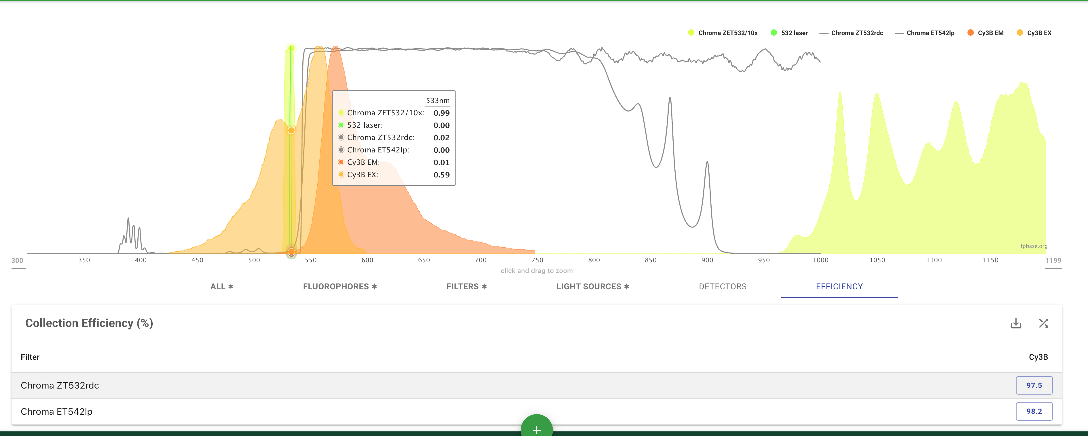
Class activity 1: design a filter set (15 mins)
Ex filter excitation efficiency: 59%
Em filter collection efficiency: 98.2%

Slide 25
Class activity 2: design a filter set pair (15 mins)
Assume you have the following laser lines: [405 nm, 488 nm, 532 nm, 561 nm, 594 nm, 640 nm]
Add the dye “Alexa Fluor 647” to the mix
Design an ideal filter set for Alexa 647 and if needed redesign your Cy3B filter set
Report your ‘Efficiency’ for Cy3B and Alexa Fluor 647 detection. You can set T% to 100 for all filters.

Slide 26
Class activity 3: design a filter set trio (15 mins)
Assume you have the following laser lines: [405 nm, 488 nm, 532 nm, 561 nm, 594 nm, 640 nm]
Add the dye “Alexa Fluor 488” to the mix
Design an ideal filter set for Alexa 488 and if needed redesign your Cy3B and Alexa Fluor 647 filter sets
Report your ‘Efficiency’ for Cy3B, Alexa Fluor 647, and Alexa Fluor 488 detection. You can set T% to 100 for all filters.

